Slide 1
Data Modelling

Slide 2
What do we do after getting insights from the data
Building data models for future predictions by using machine learning algorithms
What are the data models?
model is a file that has been trained to recognize certain types of patterns. You train a model over a set of data, providing it an algorithm that it can use to reason over and learn from those data
How?
Using Scikit-Learn software is the machine learning library for the Python programming language. It features various classification, regression and clustering algorithms including support vector machines, random forests, gradient boosting, k-means and DBSCAN, and is designed to interoperate with the Python numerical and scientific libraries NumPy and SciPy.

Slide 3
Why we are learning about machine learning?
It is important for business leaders, analysts, and developers to at least understand where to apply the technology, how it is applied, and its basic concepts

Slide 4
Machine Learning
Before we jump into data modelling… its a good idea to understand a few fundamental ideas regarding machine learning.
In this section we’ll cover some important theory and concepts surrounding machine learning.

Slide 5
Machine Learning
Section Overview:
What is Machine Learning?
Supervised Learning Process
Evaluating performance
Overfitting

Slide 6
What is Machine Learning?
Machine learning is a method of data analysis that automates analytical model building.
Using algorithms that iteratively learn from data, machine learning allows computers to find hidden insights without being explicitly programmed where to look.

Slide 7
What is it used for?
Fraud detection.
Web search results.
Real-time ads on web pages
Credit scoring.
Prediction of equipment failures.
New pricing models.
Network intrusion detection.
Recommendation Engines
Customer Segmentation
Text Sentiment Analysis
Customer Churn
Pattern and image recognition.
Email spam filtering.

Slide 8
Machine Learning
There are different types of machine learning we will focus on during the next sections of the course:
Supervised Learning
Unsupervised Learning

Slide 9
Machine Learning
Let’s begin by learning about one of the most common machine learning tasks- Supervised Learning!

Slide 10
Supervised Learning

Slide 11
Supervised Learning
Supervised learning algorithms are trained using labeled examples, such as an input where the desired output is known.
For example, a segment of text could have a category label, such as:
Spam vs. Legitimate Email
Positive vs. Negative Movie Review

Slide 12
Supervised Learning
The network receives a set of inputs along with the corresponding correct outputs, and the algorithm learns by comparing its actual output with correct outputs to find errors.
It then modifies the model accordingly.

Slide 13
Supervised Learning
Supervised learning is commonly used in applications where historical data predicts likely future events.

Slide 14
Machine Learning Process
Test
Data
Model
Training &
Building
Data
Acquisition
Data
Cleaning
Model
Testing
Model
Deployment

Slide 15
Machine Learning Process
Get your data! Customers, Sensors, etc...
Data
Acquisition

Slide 16
Machine Learning Process
Clean and format your data (using Pandas)
Data
Acquisition
Data
Cleaning

Slide 17
Machine Learning Process
Test
Data
Training
Data
Data
Acquisition
Data
Cleaning

Slide 18
Machine Learning Process
Test
Data
Model
Training &
Building
Data
Acquisition
Data
Cleaning

Slide 19
Machine Learning Process
Test
Data
Model
Training &
Building
Data
Acquisition
Data
Cleaning
Model
Testing

Slide 20
Machine Learning Process
Test
Data
Model
Training &
Building
Data
Acquisition
Data
Cleaning
Model
Testing
Adjust
Model
Parameters

Slide 21
Machine Learning Process
Test
Data
Model
Training &
Building
Data
Acquisition
Data
Cleaning
Model
Testing
Model
Deployment

Slide 22
Supervised Learning
What we just showed is a simplified approach to supervised learning, it contains an issue!
Is it fair to use our single split of the data to evaluate our models performance?
After all, we were given the chance to update the model parameters again and again.

Slide 23
Supervised Learning
To fix this issue, data is often split into 3 sets
Training Data
Used to train model parameters
Validation Data
Used to determine what model hyperparameters to adjust
Test Data
Used to get some final performance metric

Slide 24
Supervised Learning
This means after we see the results on the final test set we don’t get to go back and adjust any model parameters!
This final measure is what we label the true performance of the model to be.

Slide 25
Supervised Learning
In this course, in general we will simplify our data by using a simple train/test split.
We will simply train and then evaluate on a test set

Slide 26
Overfitting and Underfitting

Slide 27
Machine Learning
Now that we understand the full process for supervised learning, let’s touch upon the important topics of overfitting and underfitting.

Slide 28
Machine Learning
Overfitting
The model fits too much to the noise from the data.
This often results in low error on training sets but high error on test/validation sets.

Slide 29
Machine Learning
Underfitting
Model does not capture the underlying trend of the data and does not fit the data well enough.
Low variance but high bias.
Underfitting is often a result of an excessively simple model.

Slide 30
Machine Learning
We are going to use the dataframes to create a model
First let’s imagine we trained a model and then measured its error over training time.

Slide 31
Machine Learning
we split our data into a training set and a test set
And then we evaluate the performance of the model for predictions

Slide 32
Evaluating Performance
CLASSIFICATION

Slide 33
Model Evaluation
We just learned that after our machine learning process is complete, we will use performance metrics to evaluate how our model did.
Let’s discuss classification metrics in more detail!

Slide 34
Model Evaluation
The key classification metrics we need to understand are:
Accuracy
Recall
Precision
F1-Score

Slide 35
Model Evaluation
But first, we should understand the reasoning behind these metrics and how they will actually work in the real world!

Slide 36
Model Evaluation
Typically in any classification task your model can only achieve two results:
Either your model was correct in its prediction.
Or your model was incorrect in its prediction.

Slide 37
Model Evaluation
Fortunately incorrect vs correct expands to situations where you have multiple classes.
For the purposes of explaining the metrics, let’s imagine a binary classification situation, where we only have two available classes.

Slide 38
Model Evaluation
In our example, we will attempt to predict if an image is a dog or a cat.
Since this is supervised learning, we will first fit/train a model on training data, then test the model on testing data.
Once we have the model’s predictions from the X_test data, we compare it to the true y values (the correct labels).

Slide 39
Model Evaluation
TRAINED
MODEL

Slide 40

Model Evaluation
TRAINED
MODEL
Test Image
from X_test

Slide 41
Model Evaluation
TRAINED
MODEL
Test Image
from X_test
DOG
Correct Label
from y_test

Slide 42
Model Evaluation
TRAINED
MODEL
Test Image
from X_test
DOG
Prediction on
Test Image
DOG
Correct Label
from y_test

Slide 43
Model Evaluation
TRAINED
MODEL
Test Image
from X_test
DOG
Prediction on
Test Image
DOG
Correct Label
from y_test
DOG == DOG ?
Compare Prediction to Correct Label

Slide 44
Model Evaluation
TRAINED
MODEL
Test Image
from X_test
CAT
Prediction on
Test Image
DOG
Correct Label
from y_test
DOG == CAT ?
Compare Prediction to Correct Label

Slide 45
Model Evaluation
We repeat this process for all the images in our X test data.
At the end we will have a count of correct matches and a count of incorrect matches.
The key realization we need to make, is that in the real world, not all incorrect or correct matches hold equal value!

Slide 46
Model Evaluation
Also in the real world, a single metric won’t tell the complete story!
To understand all of this, let’s bring back the 4 metrics we mentioned and see how they are calculated.
We could organize our predicted values compared to the real values in a confusion matrix.

Slide 47
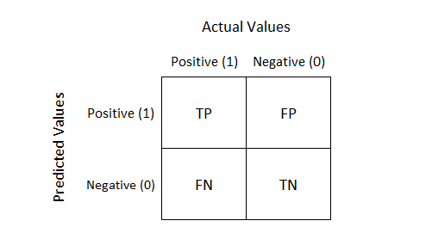
What is Confusion Matrix and why you need it?
it is a performance measurement for machine learning classification problem where output can be two or more classes
It is a table with 4 different combinations of predicted and actual values

Slide 48
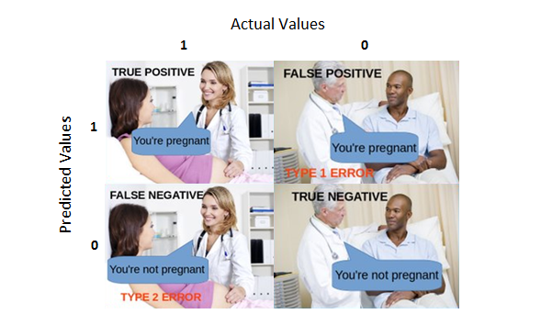
Let’s understand TP, FP, FN, TN in terms of pregnancy analogy

Slide 49
True Positive:
Interpretation: You predicted positive and it’s true.
You predicted that a woman is pregnant and she actually is.
True Negative:
Interpretation: You predicted negative and it’s true.
You predicted that a man is not pregnant and he actually is not.

Slide 50
False Positive: (Type 1 Error)
Interpretation: You predicted positive and it’s false.
You predicted that a man is pregnant but he actually is not.
False Negative: (Type 2 Error)
Interpretation: You predicted negative and it’s false.
You predicted that a woman is not pregnant but she actually is.

Slide 51
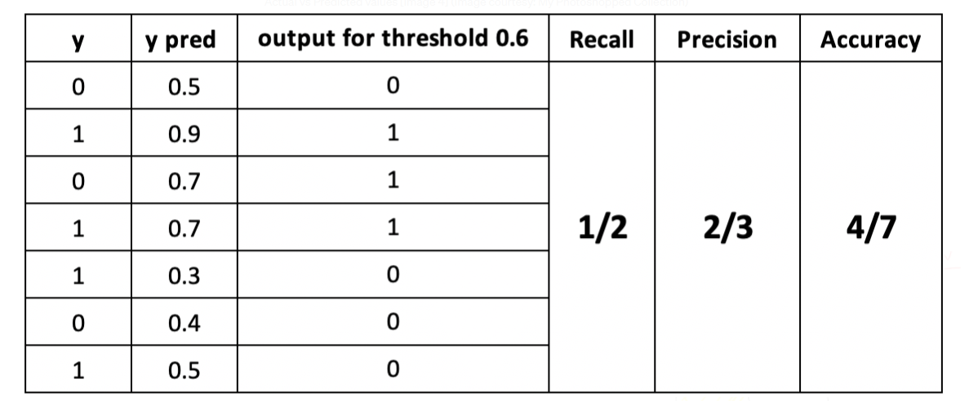
Consider following classification data

Slide 52
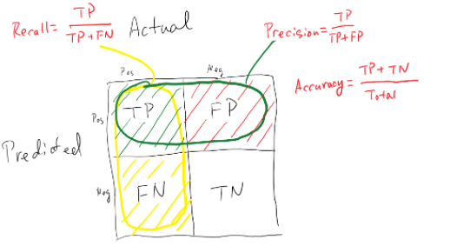



Recall should be high as possible.
Precision should be high as possible.
Accuracy should be high as possible.
It is difficult to compare two models with low precision and high recall or vice versa. So to make them comparable, we use F-Score. F-score helps to measure Recall and Precision at the same time. It uses Harmonic Mean in place of Arithmetic Mean by punishing the extreme values more

Slide 53
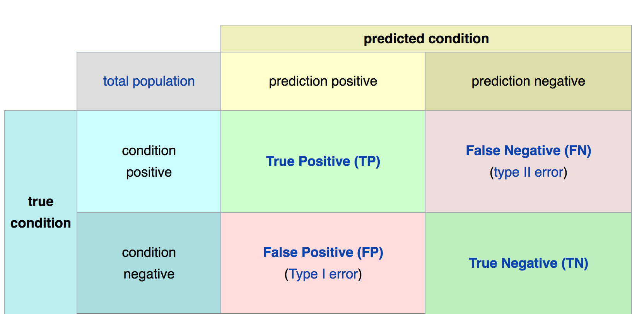
Confusion Matrix
Math &
Statistics
Machine Learning
DS
Software
Research
Domain
Knowledge

Slide 54
Model Evaluation
The main point to remember with the confusion matrix and the various calculated metrics is that they are all fundamentally ways of comparing the predicted values versus the true values.
What constitutes “good” metrics, will really depend on the specific situation!
Math &
Statistics
Machine Learning
DS
Software
Research
Domain
Knowledge

Slide 55
Evaluating Performance
REGRESSION

Slide 56
Evaluating Regression
Let’s take a moment now to discuss evaluating Regression Models
Regression is a task when a model attempts to predict continuous values (unlike categorical values, which is classification)

Slide 57
Evaluating Regression
You may have heard of some evaluation metrics like accuracy or recall.
These sort of metrics aren’t useful for regression problems, we need metrics designed for continuous values!

Slide 58
Evaluating Regression
For example, attempting to predict the price of a house given its features is a regression task.
Attempting to predict the country a house is in given its features would be a classification task.

Slide 59
Evaluating Regression
Let’s discuss some of the most common evaluation metrics for regression:
Mean Absolute Error
Mean Squared Error
Root Mean Square Error

Slide 60
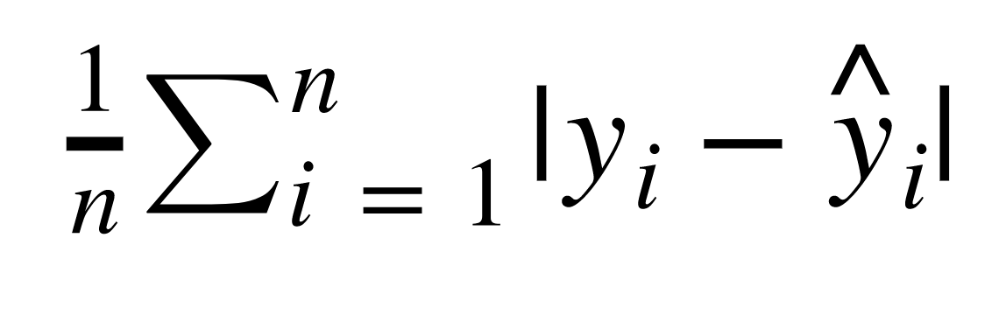
Evaluating Regression
Mean Absolute Error (MAE)
This is the mean of the absolute value of errors.
Easy to understand

Slide 61
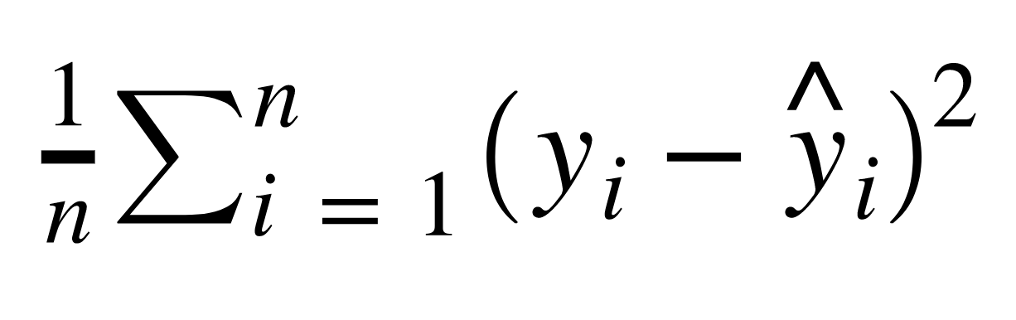
Evaluating Regression
Mean Squared Error (MSE)
This is the mean of the squared errors.
Larger errors are noted more than with MAE, making MSE more popular.

Slide 62
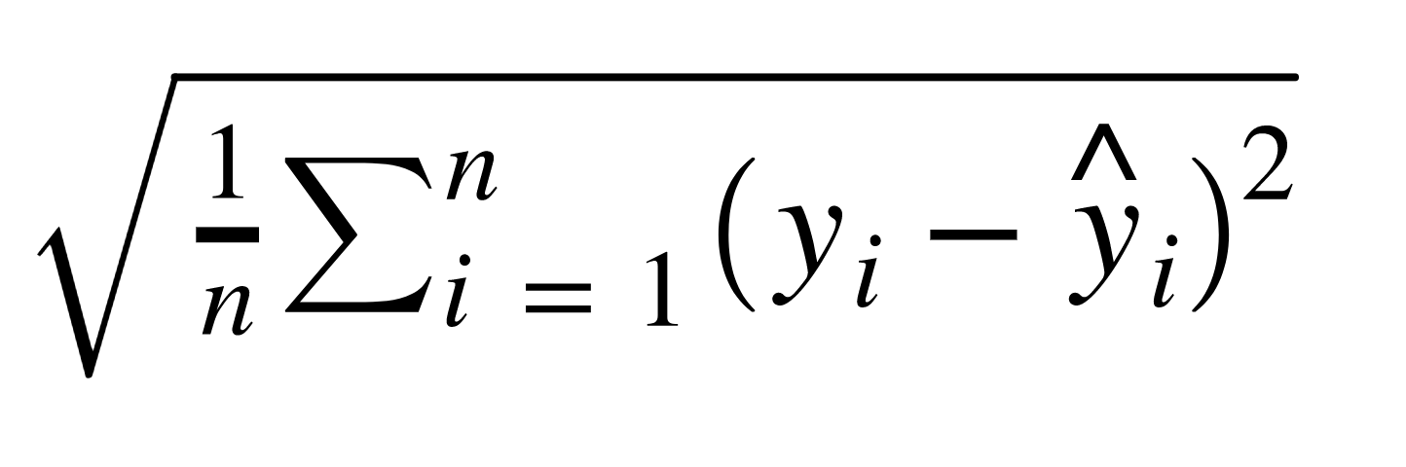
Evaluating Regression
Root Mean Square Error (RMSE)
This is the root of the mean of the squared errors.
Most popular (has same units as y)

Slide 63
Machine Learning
Most common question from students:
“Is this value of RMSE good?”
Context is everything!
A RMSE of $10 is fantastic for predicting the price of a house, but horrible for predicting the price of a candy bar!

Slide 64
Machine Learning
Compare your error metric to the average value of the label in your data set to try to get an intuition of its overall performance.
Domain knowledge also plays an important role here!

Slide 65
Machine Learning
Context of importance is also necessary to consider.
We may create a model to predict how much medication to give, in which case small fluctuations in RMSE may actually be very significant.

Slide 66
Evaluating Regression
You should now feel comfortable with the various methods of evaluating a regression task.

Slide 67
Unsupervised Learning

Slide 68
Machine Learning
We’ve covered supervised learning, where the label was known due to historical labeled data.
But what happens when we don’t have historical labels?

Slide 69
Machine Learning
There are certain tasks that fall under unsupervised learning:
Clustering
Anomaly Detection
Dimensionality Reduction

Slide 70
Machine Learning
Clustering
Grouping together unlabeled data points into categories/clusters
Data points are assigned to a cluster based on similarity

Slide 71
Machine Learning
Anomaly Detection
Attempts to detect outliers in a dataset
For example, fraudulent transactions on a credit card.

Slide 72
Machine Learning
Dimensionality Reduction
Data processing techniques that reduces the number of features in a data set, either for compression, or to better understand underlying trends within a data set.

Slide 73
Machine Learning
Unsupervised Learning
It’s important to note, these are situations where we don’t have the correct answer for historical data!
Which means evaluation is much harder and more nuanced!

Slide 74
Unsupervised Process
Test
Data
Model
Training &
Building
Data
Acquisition
Data
Cleaning
Transformation
Model
Deployment

